Slide 1
Human Learning
Process of gaining information through observation to perform some task and improve the performance in performing the task.
Why?
homework, rocket launch angle, walking on street, new course
Types
Learning under expert guidance
Learning guided by knowledge gained from experts
Learning by self

Slide 2
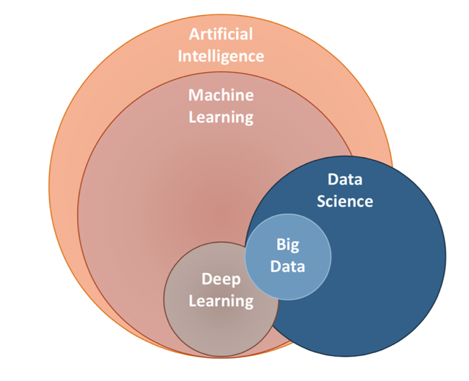
What is Machine Learning
Machine Learning is Interdisciplinary course applicable to wide variety of domains .

Slide 3
What is Machine Learning
A computer program is said to learn from experience E with respect to some class of tasks T and performance measure P, if its performance at tasks in T, as measured by P, improves with experience E.
Tom Mitchell
A checkers learning problem:
Task T: playing checkers
Performance measure P: percent of games won against opponents
Training experience E: playing practice games against itself
Fruit Prediction Problem
Task – forecasting different fruits for recognition
Performance Measure – able to predict maximum variety of fruits
Experience – training machine with the largest datasets of fruits images
Face Recognition Problem
Task – predicting different types of faces
Performance Measure – able to predict maximum types of faces
Experience – training machine with maximum amount of datasets of different face images

Slide 4
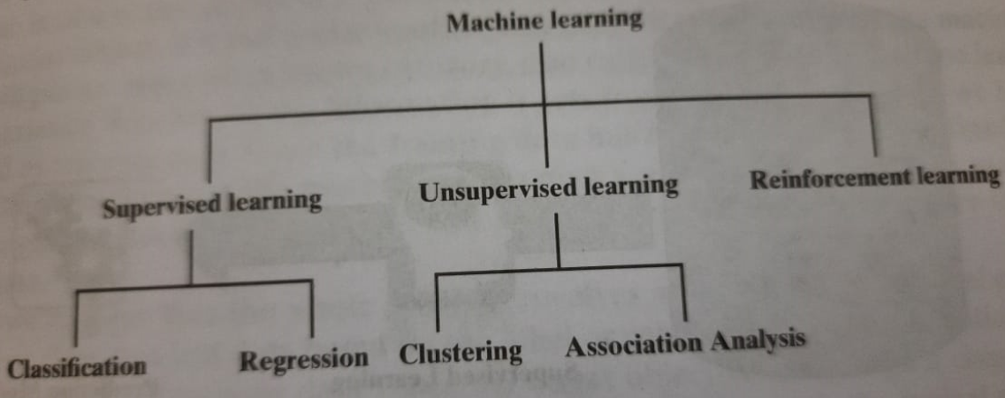
Types of Machine Learning

Slide 5
UNIT - III
Supervised Learning
Decision Tree Classifier
Model Overfitting
Model Selection

Slide 6
Supervised Learning
Basic Concepts
General Framework for Classification

Slide 7
Supervised Learning – Basic Concepts
Classification: Definition
Given a collection of records (training set )
Each record is characterized by a tuple (x,y), where x is the attribute set and y is the class label
x: attribute, predictor, independent variable, input
y: class, response, dependent variable, output
Task:
Learn a model that maps each attribute set x into one of the predefined class labels y

Slide 8
Supervised Learning – Basic Concepts
Examples of Classification
Task | Attribute set, x | Class label, y
Categorizing email messages | Features extracted from email message header and content | spam or non-spam
Identifying tumor cells | Features extracted from x-rays or MRI scans | malignant or benign cells
Cataloging galaxies | Features extracted from telescope images | Elliptical, spiral, or irregular-shaped galaxies

Slide 9
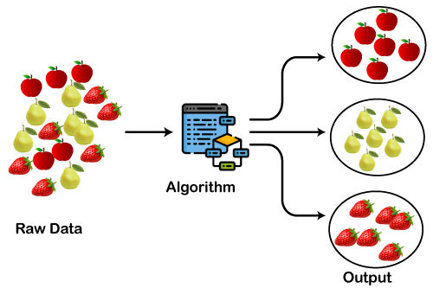
Unsupervised Learning - Clustering

Slide 10
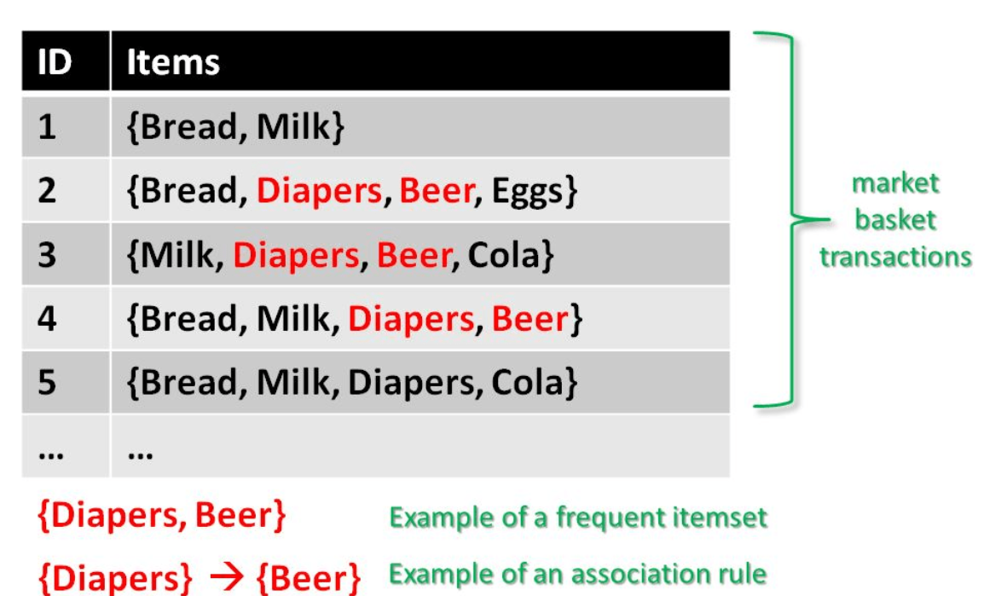
Unsupervised Learning – Association Analysis

Slide 11
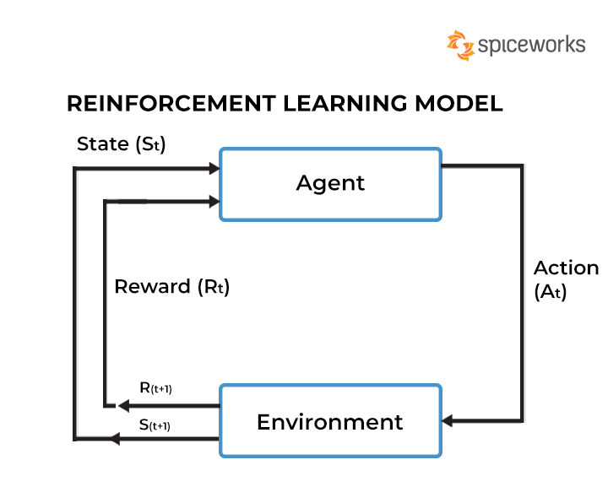
Reinforcement Learning

Slide 12
Comparison of various learnings
Supervised machine learning | Unsupervised machine learning | Reinforcement
Used for classifying (classes and labels are given) | To find pattern (No idea about class/labels) | Rewards – if guessed correctly (No idea about class/labels)
Labelled training data | Unknown and unlabeled data | Model learns and updates itself through rewards/punishment
Classification and regression | Clustering and association analysis | No such types
Simple to understand | More difficult to understand and implement | Most complex
Navie bayes, KNN, LR, SVM etc | Kmeans, PCA, DBSCAN, apriori | Q-Learning, Sarsa
Hand writing recognition, stock market prediction, disease prediction, fraud detection | Market based analysis, recommender system, customer segmentation | Self driving cars, intelligent robots

Slide 13
Problems which maynot be solved using ML
Critical applications where human are effective – Air traffic control
Simple applications – price calculator, dispute tracking application
To an already optimized business process
Insufficient training data

Slide 14
Languages and Tools
Python
R
Matlab
SAS
SPSS
Julia
Google colab
Jupiter notebook

Slide 15
Descriptive and Predictive Modeling
Descriptive: determine the similarities in the data and to find existing patterns.
Examples of descriptive: Clustering, association rule mining, and anomaly detection.
Clustering involves grouping similar objects together
Association rule mining involves identifying relationships between different items in a dataset.
Anomaly detection involves identifying unusual patterns or outliers in the data.

Slide 16
Descriptive and Predictive Modeling
Predictive: It uses the supervised learning functions which are used to predict the target value.
Examples: Regression, Decision tress, and Neural Networks
Regression involves predicting a continuous outcome variable based on one or more predictor variables
DT involves building a tree – like model based on set of rules for prediction.
Neural Networks involves building the model based on human brain to make predictions.

Slide 17
General Approach for Building Classification Model
Classification techniques are most suited for predicting or describing data sets with binary or nominal categories.
They are less effective for ordinal categories (e.g., to classify a person as a member of high-, medium-, or low- income group

Slide 18
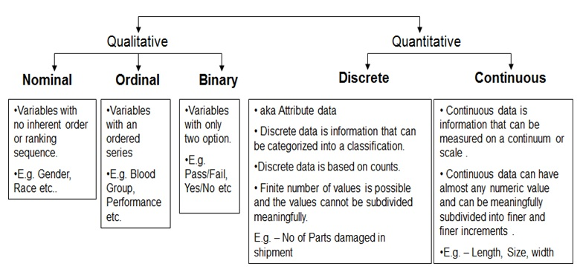
Data Attributes

Slide 19
Classification Techniques
Base Classifiers
Decision Tree based Methods
Rule-based Methods
Nearest-neighbor
Naïve Bayes and Bayesian Belief Networks
Support Vector Machines
Neural Networks, Deep Neural Nets
Ensemble Classifiers
Boosting, Bagging, Random Forests

Slide 20
Decision Tree Classifier
A Basic Algorithm to Build a Decision Tree
Methods for Expressing Attribute Test Conditions
Measures for Selecting an Attribute Test Condition
Algorithm for Decision Tree Induction
Characteristics of Decision Tree Classifiers

Slide 21
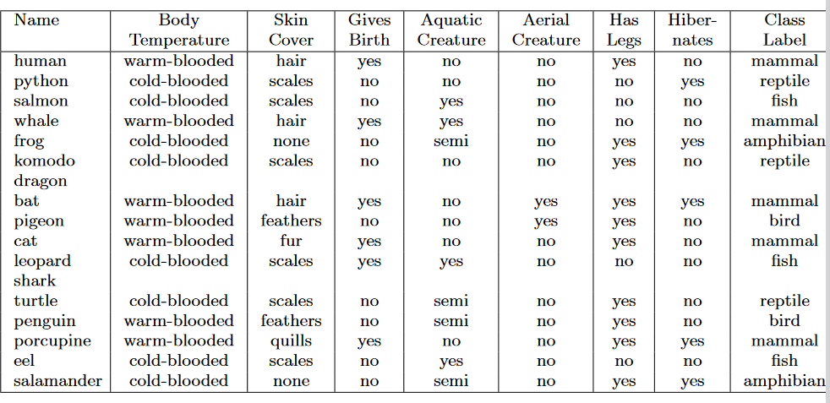
Decision Tree Classifier
The series of questions and their possible answers can be organized in the form of a decision tree

Slide 22
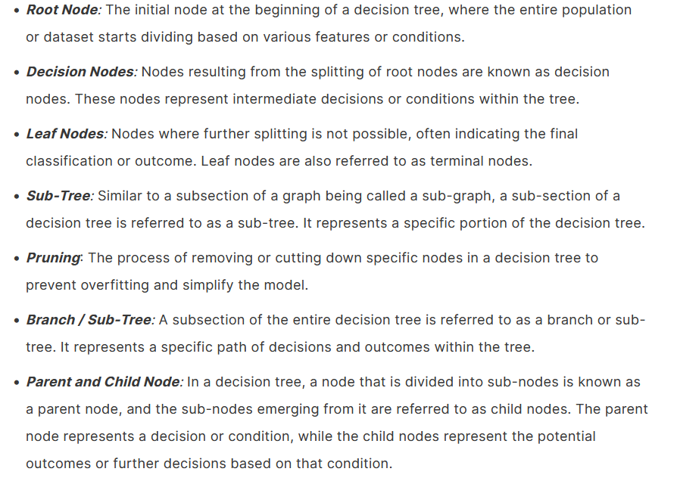
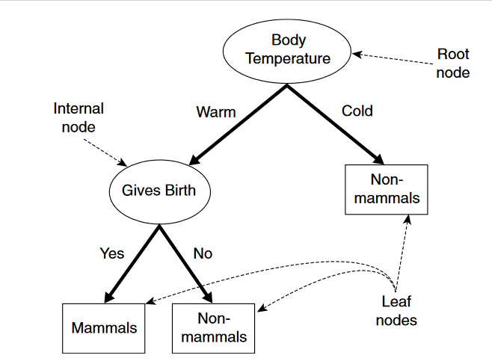
Decision Tree Classifier - Nodes
A decision tree for the mammal classification problem

Slide 23
Example of a Decision Tree
categorical
categorical
continuous
class
Splitting Attributes
Home Owner
Yes
No
NO
MarSt
Single, Divorced
Married
Income
NO
< 80K
> 80K
NO
YES
Training Data
Model: Decision Tree

Slide 24
Apply Model to Test Data
Test Data
Start from the root of tree.
Home Owner
Yes
No
NO
MarSt
Single, Divorced
Married
Income
NO
< 80K
> 80K
NO
YES

Slide 25
Apply Model to Test Data
Test Data
Home Owner
Yes
No
NO
MarSt
Single, Divorced
Married
Income
NO
< 80K
> 80K
NO
YES

Slide 26
Apply Model to Test Data
Test Data
Home Owner
Yes
No
NO
MarSt
Single, Divorced
Married
Income
NO
< 80K
> 80K
NO
YES

Slide 27
Apply Model to Test Data
Test Data
Home Owner
Yes
No
NO
MarSt
Single, Divorced
Married
Income
NO
< 80K
> 80K
NO
YES

Slide 28
Apply Model to Test Data
Test Data
Home Owner
Yes
No
NO
MarSt
Single, Divorced
Married
Income
NO
< 80K
> 80K
NO
YES

Slide 29
Apply Model to Test Data
Test Data
Home Owner
Yes
No
NO
MarSt
Single, Divorced
Married
Assign Defaulted to “No”
Income
NO
< 80K
> 80K
NO
YES

Slide 30
Another Example of Decision Tree
categorical
categorical
continuous
class
Single, Divorced
MarSt
Married
NO
Home Owner
Yes
No
NO
Income
< 80K
> 80K
NO
YES
There could be more than one tree that fits the same data!

Slide 31
Decision Tree Classification Task
Decision Tree

Slide 32
Decision Tree Induction
Many Algorithms:
Hunt’s Algorithm (one of the earliest)
CART
ID3, C4.5
SLIQ,SPRINT

Slide 33
General Structure of Hunt’s Algorithm
Let D_{t} be the set of training records that reach a node t
General Procedure:
If D_{t} contains records that belong the same class y_{t}, then t is a leaf node labeled as y_{t}
If D_{t} contains records that belong to more than one class, use an attribute test to split the data into smaller subsets. Recursively apply the procedure to each subset.
D_{t}
?

Slide 34
Hunt’s Algorithm
(7,3)
(3,0)
(4,3)
(3,0)
(3,0)
(3,0)
(1,3)
(3,0)
(1,0)
(0,3)

Slide 35
Design Issues of Decision Tree Induction
How should training records be split?
Greedy strategy: split the records based on some attribute test (always choose immediate best option)
Need to evaluate the “goodness” of each attribute test and select the best one.
How should the splitting procedure stop?
Stop splitting if all the records belong to the same class or have identical attribute values
Early termination

Slide 36
Methods for Expressing Test Conditions
Depends on attribute types
Binary
Nominal
Ordinal
Continuous

Slide 37
Test Condition for Nominal Attributes
Multi-way split:
Use as many partitions as distinct values.
Binary split:
Divides values into two subsets

Slide 38
Test Condition for Ordinal Attributes
Multi-way split:
Use as many partitions as distinct values
Binary split:
Divides values into two subsets
Preserve order property among attribute values
This grouping violates order property

Slide 39
Test Condition for Ordinal Attributes

Slide 40
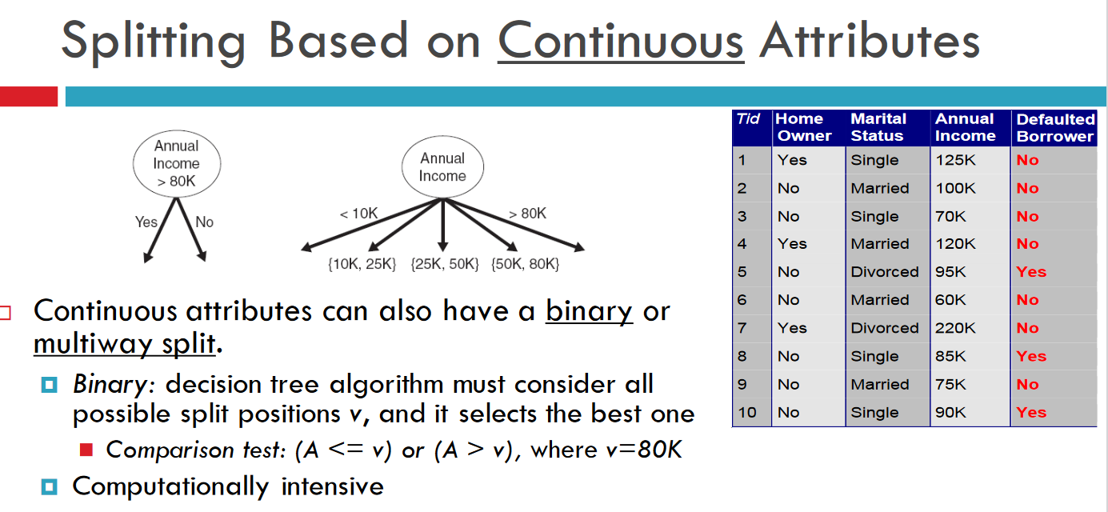
Test Condition for Continuous Attributes

Slide 41
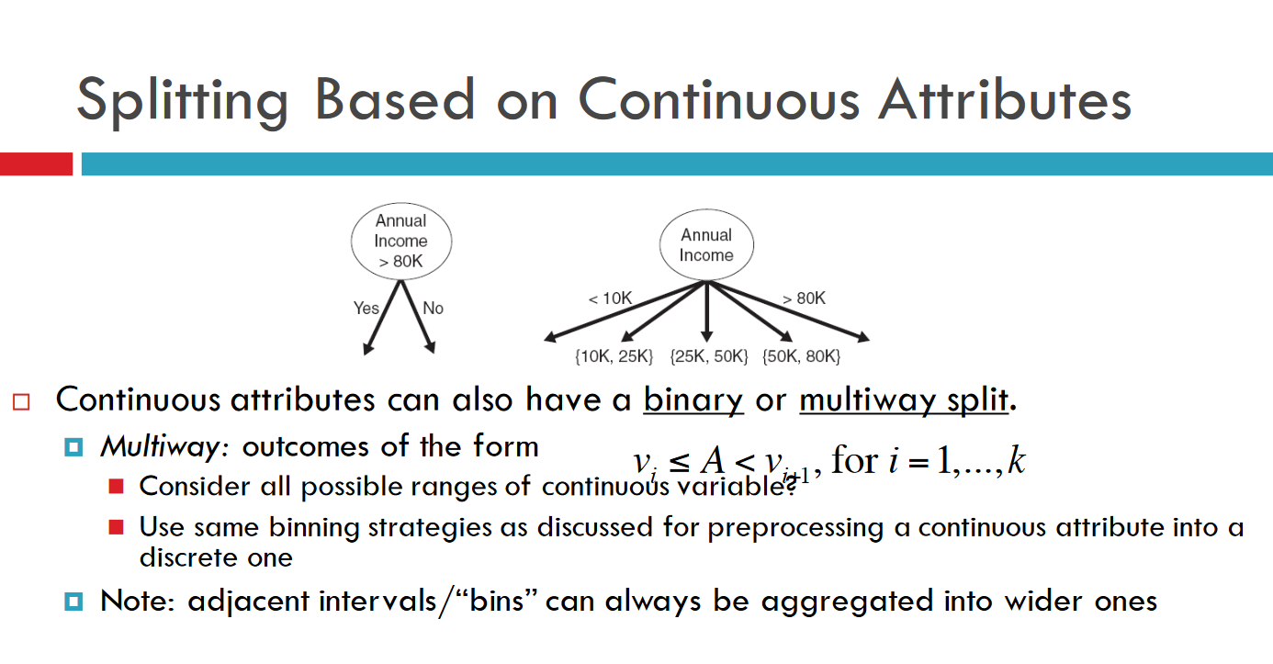
Split Condition for Continuous Attributes

Slide 42
Binning or Discretization
Real-world data tend to be noisy.
Noisy data is data with a large amount of additional meaningless information in it called noise.
Data cleaning (or data cleansing) routines attempt to smooth out noise while identifying outliers in the data.
Three methods to smoothen the data:
Binning: smooth a sorted data value by consulting its “neighborhood”, that is, the values around it.
Regression
Outlier analysis
Which test condition is the best?

Slide 43
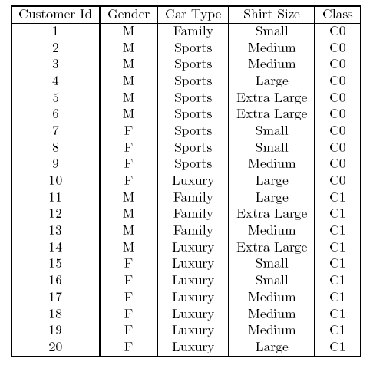
How to determine the Best Split
Before Splitting: 10 records of class 0,
10 records of class 1
Which test condition is the best?

Slide 44
How to determine the Best Split
Greedy approach:
Nodes with purer class distribution are preferred
Need a measure of node impurity:
High degree of impurity
Low degree of impurity

Slide 45
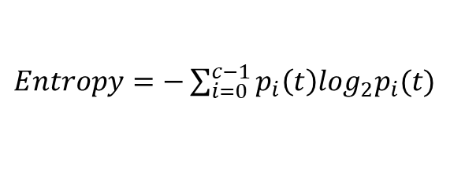
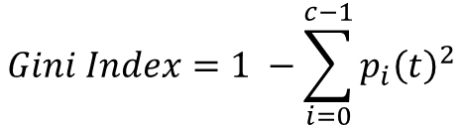
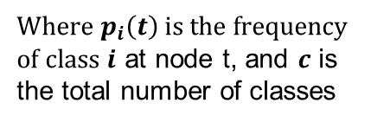
Measures of Node Impurity
Gini Index
measures the degree of probability of a particular variable being incorrectly classified when it is chosen randomly.
Entropy
Measures the degree of uncertainty
Misclassification error
$$Gini Index=1 −\sum_{i=0}^{c−1}{p_{i}{\left(t\right)}^{2}}$$
Where $p_{i}\left(t\right)$ is the frequency of class $i$ at node t, and $c$ is the total number of classes
$Entropy=−\sum_{i=0}^{c−1}{p_{i}\left(t\right)log_{2}p_{i}(t)}$
$$Classification error={1 −max⁡[p}_{i}(t)]$$

Slide 46
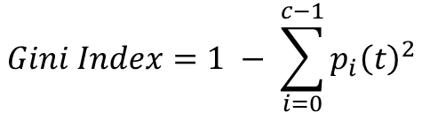
Computing Gini Index of a Single Node
$$Gini Index=1 − \sum_{i=0}^{c−1}{p_{i}{\left(t\right)}^{2}}$$
P(C1) = 0/6 = 0 P(C2) = 6/6 = 1
Gini = 1 – P(C1)² – P(C2)² = 1 – 0 – 1 = 0
P(C1) = 1/6 P(C2) = 5/6
Gini = 1 – (1/6)² – (5/6)² = 0.278
P(C1) = 2/6 P(C2) = 4/6
Gini = 1 – (2/6)² – (4/6)² = 0.444

Slide 47
Binary Attributes: Computing GINI Index
Splits into two partitions (child nodes)
Effect of Weighing partitions:
Larger and purer partitions are sought
B?
Yes
No
Node N1
Node N2
Gini(N1) = 1 – (5/6)² – (1/6)² = 0.278
Gini(N2) = 1 – (2/6)² – (4/6)² = 0.444
Weighted Gini of N1 N2 = 6/12 * 0.278 + 6/12 * 0.444 = 0.361
Gain = 0.486 – 0.361 = 0.125

Slide 48
Categorical Attributes: Computing Gini Index
For each distinct value, gather counts for each class in the dataset
Use the count matrix to make decisions
Multi-way split
Two-way split
(find best partition of values)
Which of these is the best?

Slide 49
Continuous Attributes: Computing Gini Index
Use Binary Decisions based on one value
Several Choices for the splitting value
Number of possible splitting values = Number of distinct values
Each splitting value has a count matrix associated with it
Class counts in each of the partitions, A ≤ v and A > v
Simple method to choose best v
For each v, scan the database to gather count matrix and compute its Gini index
Computationally Inefficient! Repetition of work.
Annual Income ?
 | ≤ 80 | > 80
Defaulted Yes | 0 | 3
Defaulted No | 3 | 4

Slide 50
Continuous Attributes: Computing Gini Index...
For efficient computation: for each attribute,
Sort the attribute on values
Linearly scan these values, each time updating the count matrix and computing gini index
Choose the split position that has the least gini index
Sorted Values

Slide 51
Continuous Attributes: Computing Gini Index...
For efficient computation: for each attribute,
Sort the attribute on values
Linearly scan these values, each time updating the count matrix and computing gini index
Choose the split position that has the least gini index
Sorted Values
Split Positions

Slide 52
Continuous Attributes: Computing Gini Index...
For efficient computation: for each attribute,
Sort the attribute on values
Linearly scan these values, each time updating the count matrix and computing gini index
Choose the split position that has the least gini index
Sorted Values
Split Positions

Slide 53
Continuous Attributes: Computing Gini Index...
For efficient computation: for each attribute,
Sort the attribute on values
Linearly scan these values, each time updating the count matrix and computing gini index
Choose the split position that has the least gini index
Sorted Values
Split Positions

Slide 54
Continuous Attributes: Computing Gini Index...
For efficient computation: for each attribute,
Sort the attribute on values
Linearly scan these values, each time updating the count matrix and computing gini index
Choose the split position that has the least gini index
Sorted Values
Split Positions

Slide 55
Measures of Node Impurity
Among these three impurity measurements:
Gini is Used by the CART (classification and regression tree) algorithm for classification trees, and
Entropy is Used by the ID3, C4.5, and C5.0 tree-generation algorithms.

Slide 56
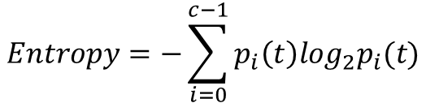
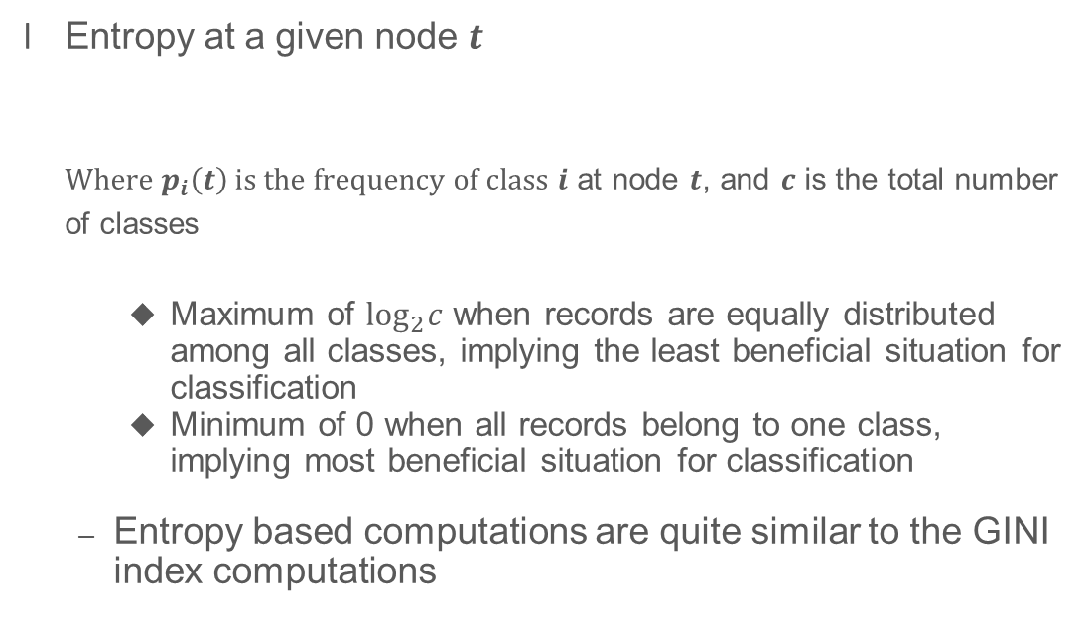
Measure of Impurity: Entropy
Entropy at a given node $t$
Where $p_{i}\left(t\right)$ is the frequency of class $i$ at node $t$, and $c$ is the total number of classes
Maximum of $\log_{2}c$ when records are equally distributed among all classes, implying the least beneficial situation for classification
Minimum of 0 when all records belong to one class, implying most beneficial situation for classification
Entropy based computations are quite similar to the GINI index computations
$$Entropy=−\sum_{i=0}^{c−1}{p_{i}\left(t\right)log_{2}p_{i}(t)}$$

Slide 57
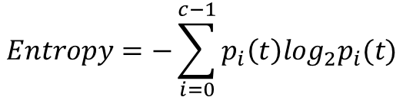
Computing Entropy of a Single Node
$$Entropy=−\sum_{i=0}^{c−1}{p_{i}\left(t\right)log_{2}p_{i}(t)}$$
P(C1) = 0/6 = 0 P(C2) = 6/6 = 1
Entropy = – 0 log 0 – 1 log 1 = – 0 – 0 = 0
P(C1) = 1/6 P(C2) = 5/6
Entropy = – (1/6) log₂ (1/6) – (5/6) log₂ (1/6) = 0.65
P(C1) = 2/6 P(C2) = 4/6
Entropy = – (2/6) log₂ (2/6) – (4/6) log₂ (4/6) = 0.92

Slide 58
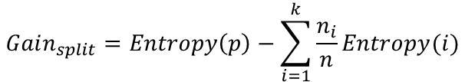
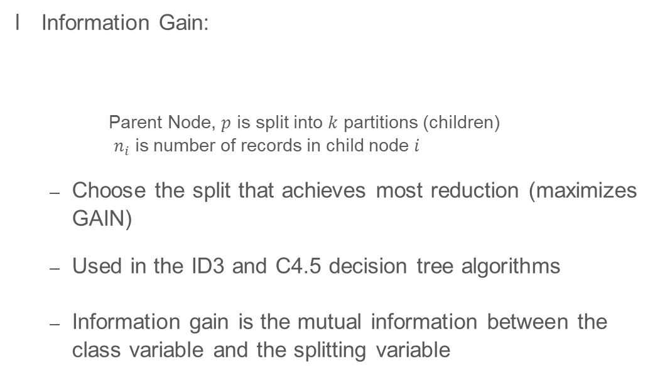
Computing Information Gain After Splitting
Information Gain:
Parent Node, $p$ is split into $k$ partitions (children)
$n_{i}$ is number of records in child node $i$
Choose the split that achieves most reduction (maximizes GAIN)
Used in the ID3 and C4.5 decision tree algorithms
Information gain is the mutual information between the class variable and the splitting variable
$$Gain_{split}=Entropy\left(p\right)−\sum_{i=1}^{k}{\frac{n_{i}}{n}Entropy(i)}$$

Slide 59

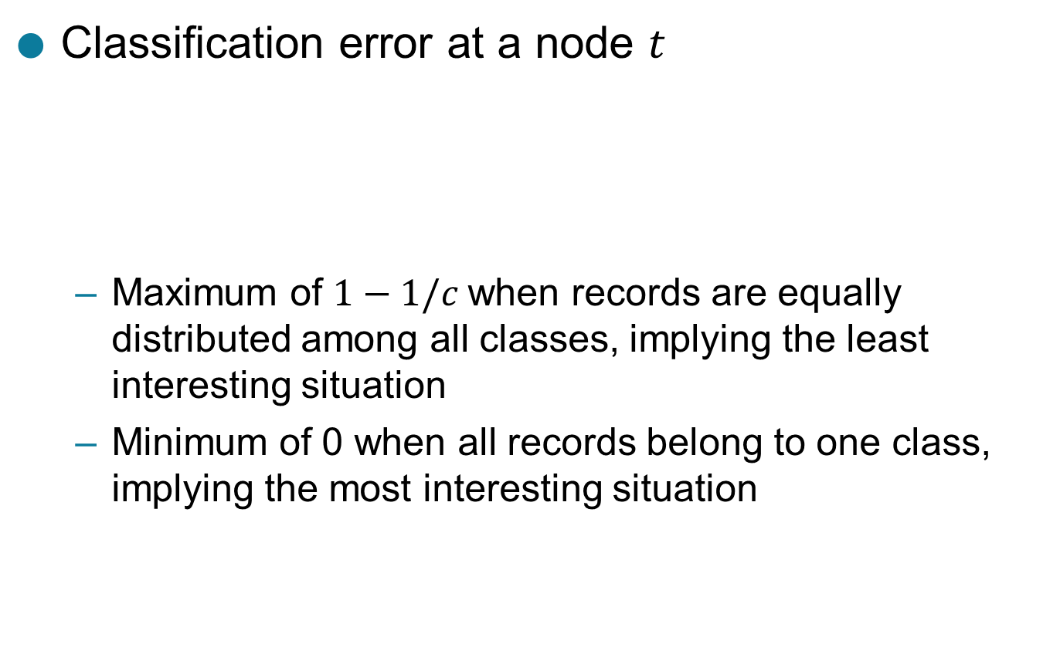
Measure of Impurity: Classification Error
Classification error at a node $t$
Maximum of $1−1/c$when records are equally distributed among all classes, implying the least interesting situation
Minimum of 0 when all records belong to one class, implying the most interesting situation
$$Error\left(t\right)=\underset{ i}{1 −max}⁡[p_{i}\left(t\right)]$$

Slide 60

Computing Error of a Single Node
$$Error\left(t\right)=\underset{ i}{1 −max}⁡[p_{i}\left(t\right)]$$
P(C1) = 0/6 = 0 P(C2) = 6/6 = 1
Error = 1 – max (0, 1) = 1 – 1 = 0
P(C1) = 1/6 P(C2) = 5/6
Error = 1 – max (1/6, 5/6) = 1 – 5/6 = 1/6
P(C1) = 2/6 P(C2) = 4/6
Error = 1 – max (2/6, 4/6) = 1 – 4/6 = 1/3

Slide 61
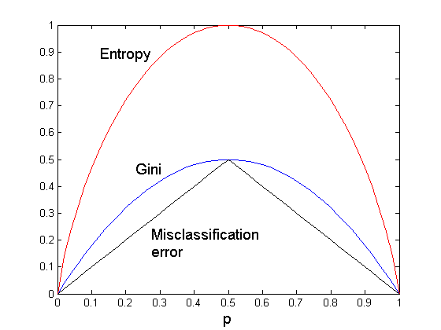
Comparison among Impurity Measures
For a 2-class problem:

Slide 62
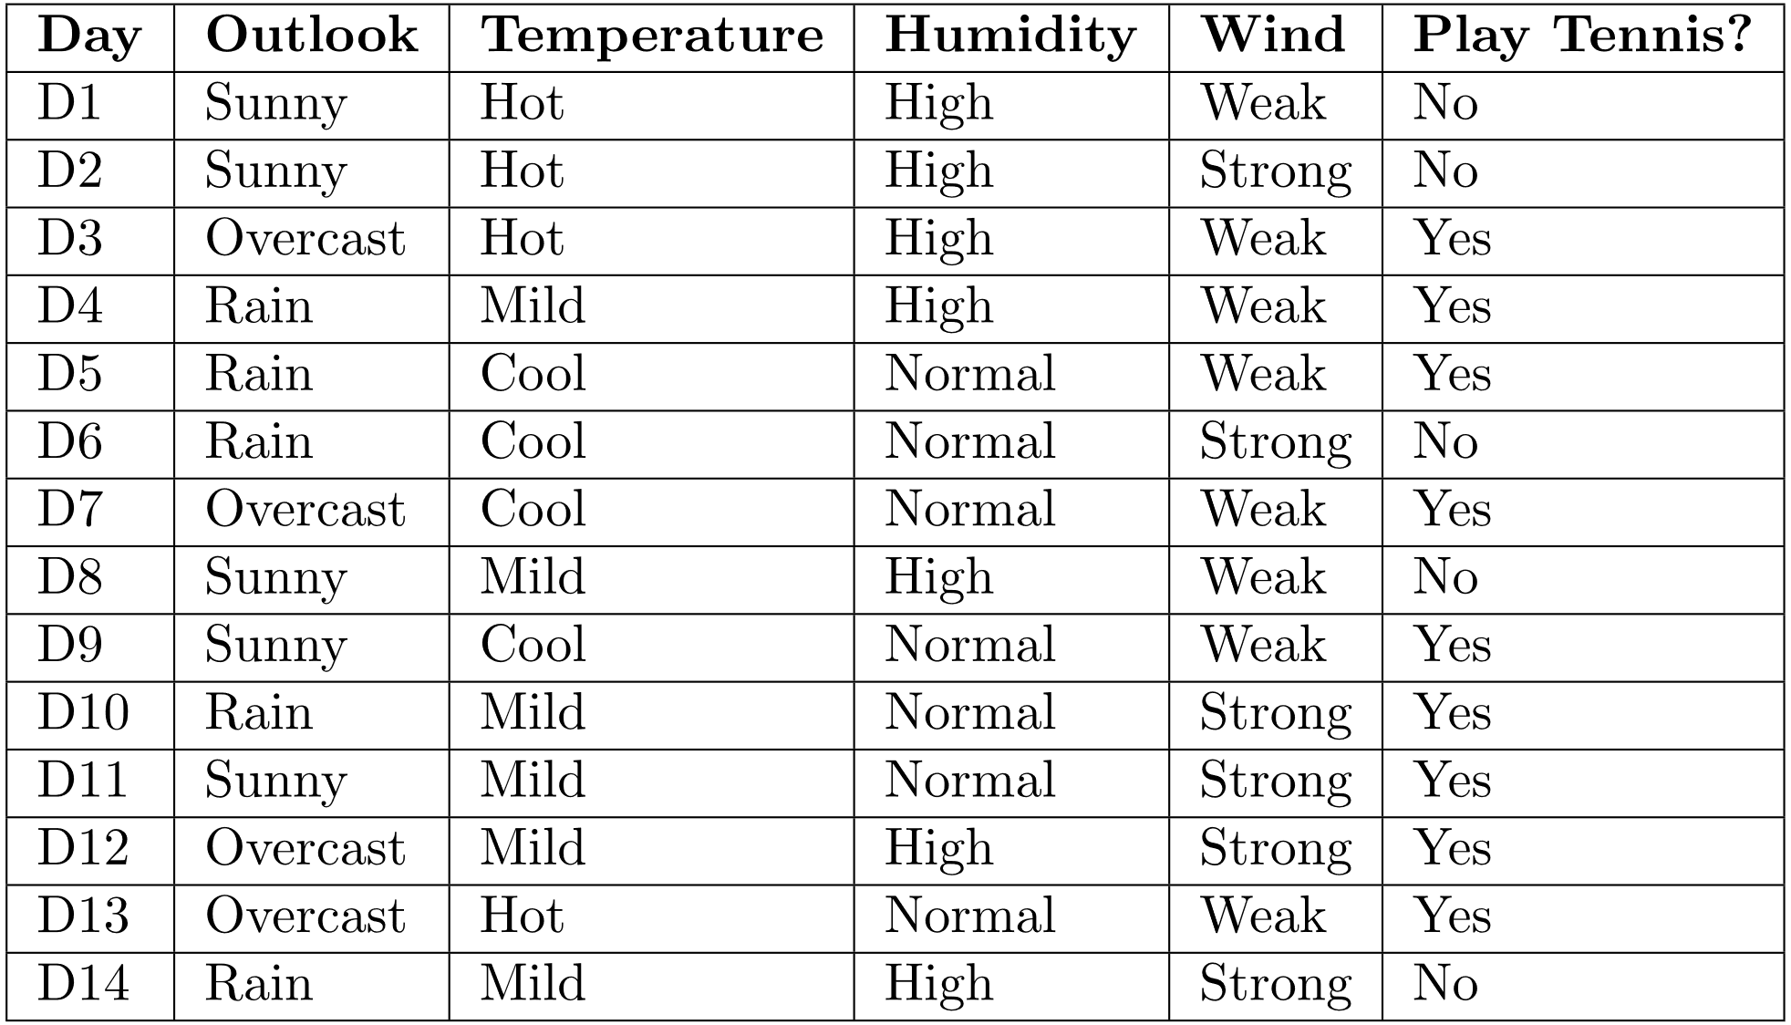
Example: Splitting by Information Gain

Slide 63
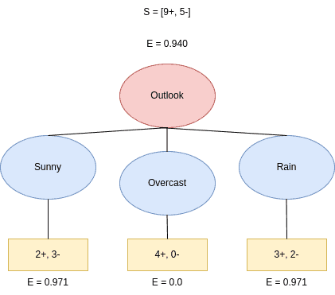
Example: Splitting by Information Gain
The dataset has 9 +ve and 5 –ve thus making dataset has S = [+9 -5]
Let’s see what happens if we split by Outcome. Outlook has three different values: Sunny, Overcast, and Rain.
The possibility of splits are : sunny = [2+, 3-], overcast = [4+, 0-], rainy = [3+, 2-]
Information Gain = 0.940 – 5/14(0.970) – 4/14(0) – 5/14(0.971) = 0.247
Now split the tree based on wind feature – weak and strong = [6+, 2-] and [3+, 3-]

Slide 64
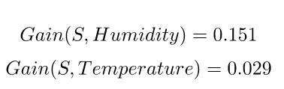
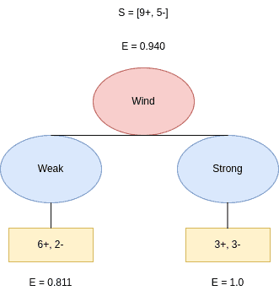
Example: Splitting by Information Gain
we calculate the gains for Humidity and Temperature as well.
Information Gain = 0.940 – 8/14(0.811) – 6/14(1) = 0.048
We see that the feature with the maximum Information Gain is Outlook. Thus, we conclude that Outlook is the best attribute to split the data at the tree’s root.

Slide 65
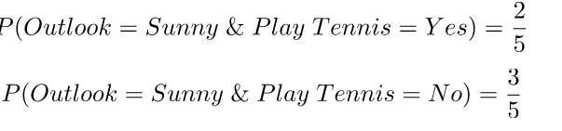
Example: Splitting by Gini Index
We can split the data by the Gini Index too. Let’s compute the required probabilities:
Out of the 14 days in the above example, Sunny, Overcast, and Rain occur 5, 4, and 5 times, respectively.
Then, we compute the probabilities of a Sunny day and playing tennis or not.
Out of the 5 times when Outlook=Sunny, we played tennis on 2 and didn’t play it on 3 days:

Slide 66
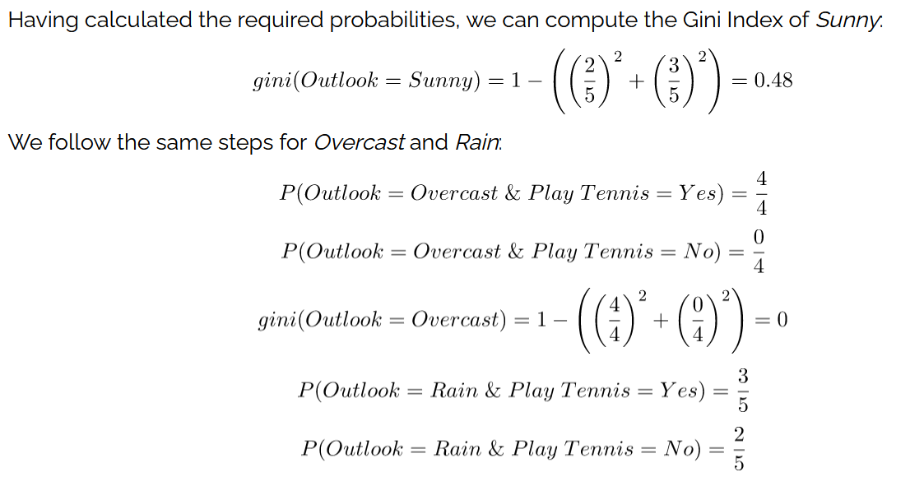
Example: Splitting by Gini Index

Slide 67
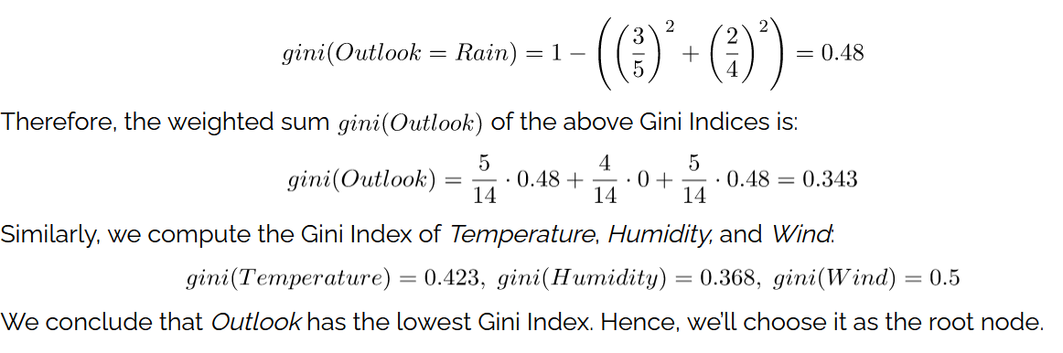
Example: Splitting by Gini Index

Slide 68
Characteristics of DT
Non parametric approach – doesn’t require any prior assumptions like type of probability distribution
Optimal – DT is a NP problem – no optimal solution
Techniques developed for constructing decision trees are computationally inexpensive, making it possible to quickly construct models even when the training set size is very large.
Decision trees, especially smaller-sized trees, are relatively easy to interpret.
Decision tree algorithms are quite robust to the presence of noise, especially when methods for avoiding overfitting were employed
The presence of redundant attributes does not adversely affect the accuracy of decision trees - An attribute is redundant if it is strongly correlated with another attribute in the data.
Studies have shown that the choice of impurity measure has little effect on the performance of decision tree induction algorithms.

Slide 69
Decision Tree Based Classification
Advantages:
Relatively inexpensive to construct
Extremely fast at classifying unknown records
Easy to interpret for small-sized trees
Robust to noise (especially when methods to avoid overfitting are employed)
Can easily handle redundant attributes
Can easily handle irrelevant attributes (unless the attributes are interacting)
Disadvantages: .
Due to the greedy nature of splitting criterion, interacting attributes (that can distinguish between classes together but not individually) may be passed over in favor of other attributed that are less discriminating.
Each decision boundary involves only a single attribute

Slide 70
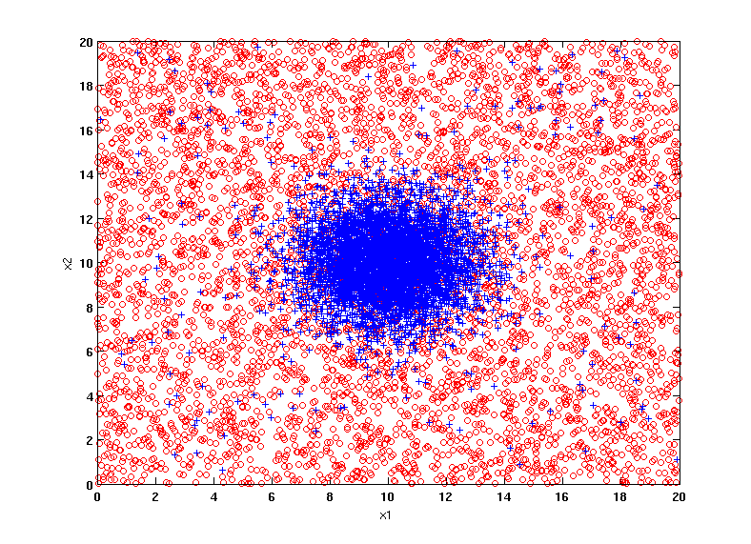
Example Data Set
Two class problem:
+ : 5400 instances
5000 instances generated from a Gaussian centered at (10,10)
400 noisy instances added
o : 5400 instances
Generated from a uniform distribution
10 % of the data used for training and 90% of the data used for testing

Slide 71
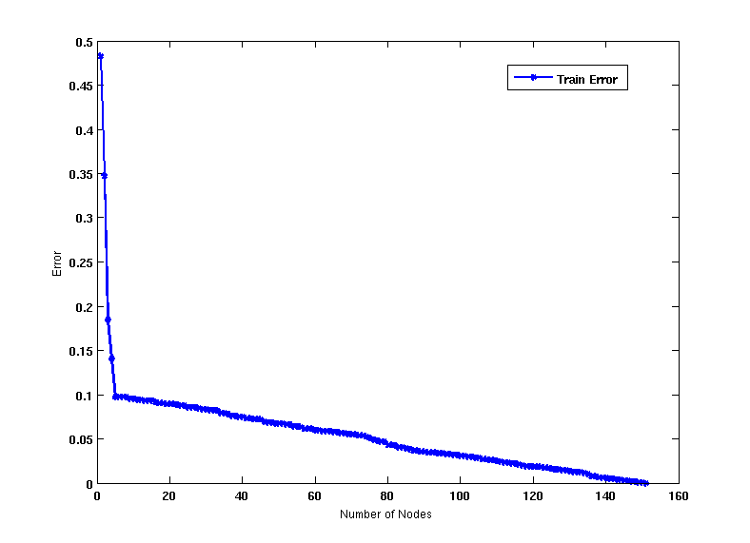
Increasing number of nodes in Decision Trees

Slide 72
Decision Tree with 4 nodes
Decision Tree
Decision boundaries on Training data

Slide 73
Decision Tree with 50 nodes
Decision Tree
Decision Tree
Decision boundaries on Training data

Slide 74
Which tree is better?
Decision Tree with 4 nodes
Which tree is better ?
Decision Tree with 50 nodes

Slide 75
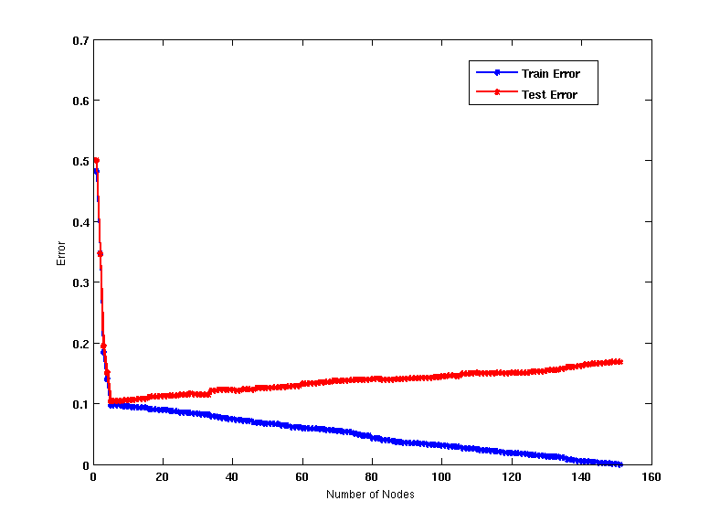
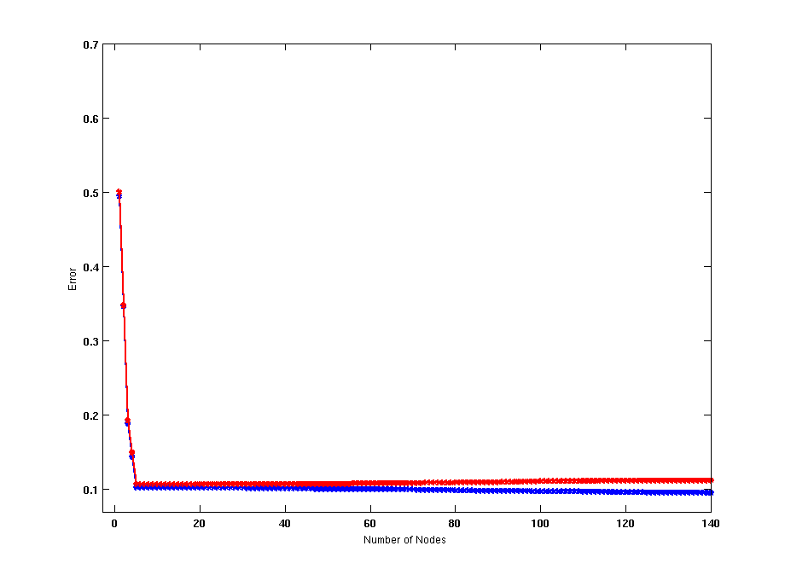
Model Overfitting – Impact of Training Data Size
Using twice the number of data instances
Increasing the size of training data reduces the difference between training and testing errors at a given size of model

Slide 76
Model Overfitting – Impact of Training Data Size
Decision Tree with 50 nodes
Decision Tree with 50 nodes
Using twice the number of data instances
Increasing the size of training data reduces the difference between training and testing errors at a given size of model

Slide 77
Reasons for Model Overfitting
Not enough training data
High model complexity
Multiple Comparison Procedure

Slide 78
Model Overfitting
What is Overfitting?
Overfitting occurs when a model fits too closely to the training data and may become less accurate when encountering new data or predicting future outcomes.
In an overfit condition, a model memorizes the noise of the training data and fails to capture essential patterns
In decision trees, In order to fit the data (even noisy data), the model keeps generating new nodes and ultimately the tree becomes too complex to interpret.

Slide 79
Model Overfitting
Techniques to overcome overfitting:
Post-Pruning:
Post-Pruning or ‘backward pruning’ is a technique that eliminates branches from a “completely grown” decision tree model to reduce its complexity and variance.
This technique allows the decision tree to grow to its full depth, then removes branches to prevent the model from overfitting.
By doing so, the model might slightly increase the training error but drastically decrease the testing error

Slide 80
Model Overfitting
Techniques to overcome overfitting:
Pruning is a technique that removes parts of the decision tree and prevents it from growing to its full depth.
Pre-Pruning, also known as ‘Early Stopping’ or ‘Forward Pruning’, stops the growth of the decision tree — preventing it from reaching its full depth.
The hyperparameters that can be tuned for pre-pruning or early stopping are
max_depth (if not specified - nodes are expanded until all leaves are pure or until all leaves contain less than min_samples_split samples.
min_samples_leaf (samples required at leaf node)
and min_samples_split - Specifies the minimum number of samples required to split an internal node.

Slide 81
Model Overfitting
The training data size is too small and does not contain enough data samples to accurately represent all possible input data values.
• The training data contains large amounts of irrelevant information, called noisy data.
• The model trains for too long on a single sample set of data.
• The model complexity is high, so it learns the noise within the training data.

Slide 82
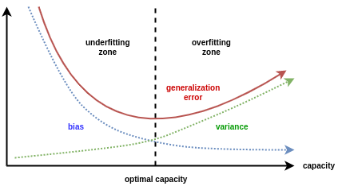
Generalization Error
generalization error is a measure of how accurately an algorithm is able to predict outcome values for previously unseen data.

Slide 83
UNIT-3 : Model Selection
Using a Validation Set, Incorporating Model Complexity, Estimating Statistical Bounds, Model Selection for Decision Trees, Model Evaluation

Slide 84
Model Selection
The process of selecting a model with the right level of complexity, which is expected to generalize well over unseen test instances, is known as model selection
Performed during model building
Purpose is to ensure that model is not overly complex (to avoid overfitting)
Need to estimate generalization error
Using Validation Set
Incorporating Model Complexity

Slide 85
Model Selection: Using Validation Set
Divide training data into two parts:
Training set:
use for model building
Validation set:
use for estimating generalization error
Note: validation set is not the same as test set
Drawback:
Less data available for training
A validation set is a subset of your data that is not used for training your model, but for evaluating its performance on unseen data.
A validation set helps you tune your model's hyperparameters, such as learning rate, regularization, or number of hidden layers, and select the best model among different candidates.

Slide 86
Model Selection: Incorporating Model Complexity
Rationale: Occam’s Razor
Given two models of similar generalization errors, one should prefer the simpler model over the more complex model
A complex model has a greater chance of being fitted accidentally by error in data.
Therefore, one should include model complexity when evaluating a model
Gen. Error(Model) = Train. Error(Model, Train. Data) + α x Complexity(Model)
Notes:
err(T): error rate on all training records
Ω: trade-off hyper-parameter (similar to α), representing the relative cost of adding a leaf node
k: number of leaf nodes
N_{train}: total number of training records

Slide 87
Estimating the Complexity of Decision Trees
Pessimistic Error Estimate of decision tree T with k leaf nodes:
err(T): error rate on all training records
Ω: trade-off hyper-parameter (similar to α )
Relative cost of adding a leaf node
k: number of leaf nodes
N_{train}: total number of training records

Slide 88
Estimating the Complexity of Decision Trees: Example
e(T_{L}) = 4/24
e(T_{R}) = 6/24
Ω = 1
e_{gen}(T_{L}) = 4/24 + 1*7/24 = 11/24 = 0.458
e_{gen}(T_{R}) = 6/24 + 1*4/24 = 10/24 = 0.417

Slide 89
Estimating the Complexity of Decision Trees
Resubstitution Estimate:
Using training error as an optimistic estimate of generalization error
Referred to as optimistic error estimate
e(T_{L}) = 4/24
e(T_{R}) = 6/24

Slide 90
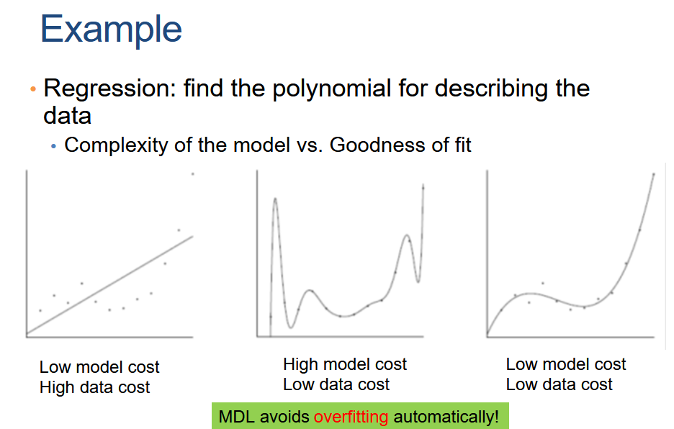
Minimum Description Length (MDL)
Description length consists of two terms:
Cost of describing the model (model cost)
Cost of describing the data given the model (data cost)
L(D) = L(M) + L(D|M)
However there is a tradeoff between the two costs:
Very complex models describe the data in a lot of
detail but are expensive to describe
Very simple models are cheap to describe but require a
lot of work to describe the data given the model.

Slide 91
MDL and Data Mining
Why does the shorter encoding make sense?
Shorter encoding implies regularities in the data
Regularities in the data imply patterns
Patterns are interesting
Example
00001000010000100001000010000100001000010001000010000100001
Short description length, just repeat 12 times 00001
0100111001010011011010100001110101111011011010101110010011100
Random sequence, no patterns, no compression

Slide 92
Minimum Description Length (MDL)
Cost(Model,Data) = Cost(Data|Model) + α x Cost(Model)
Cost is the number of bits needed for encoding.
Search for the least costly model.
Cost(Data|Model) encodes the misclassification errors.
Cost(Model) uses node encoding (number of children) plus splitting condition encoding.

Slide 93
Model Selection for Decision Trees
Pre-Pruning (Early Stopping Rule)
Stop the algorithm before it becomes a fully-grown tree
Typical stopping conditions for a node:
Stop if all instances belong to the same class
Stop if all the attribute values are the same
More restrictive conditions:
Stop if number of instances is less than some user-specified threshold
Stop if class distribution of instances are independent of the available features (e.g., using χ ² test)
Stop if expanding the current node does not improve impurity measures (e.g., Gini or information gain).
Stop if estimated generalization error falls below certain threshold

Slide 94
Model Selection for Decision Trees
Post-pruning
Grow decision tree to its entirety
Subtree replacement
Trim the nodes of the decision tree in a bottom-up fashion
If generalization error improves after trimming, replace sub-tree by a leaf node
Class label of leaf node is determined from majority class of instances in the sub-tree
Subtree raising
the most frequently used branch of the subtree

Slide 95
Example of Post-Pruning
Training Error (Before splitting) = 10/30
Pessimistic error = (10 + 0.5)/30 = 10.5/30
Training Error (After splitting) = 9/30
Pessimistic error (After splitting)
= (9 + 4 × 0.5)/30 = 11/30
PRUNE!
Class = Yes | 20
Class = No | 10
Error = 10/30
Class = Yes | 8
Class = No | 4
Class = Yes | 3
Class = No | 4
Class = Yes | 4
Class = No | 1
Class = Yes | 5
Class = No | 1

Slide 96
Model Evaluation
Purpose:
To estimate performance of classifier on previously unseen data (test set) – Model Evaluation
Holdout
Reserve k% for training and (100-k)% for testing
Random subsampling: repeated holdout
Cross validation
Partition data into k disjoint subsets
k-fold: train on k-1 partitions, test on the remaining one
Leave-one-out: k=n

Slide 97
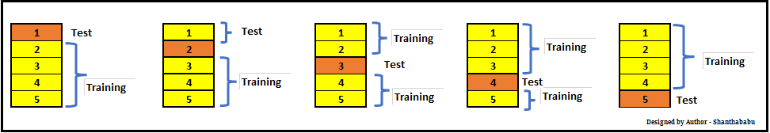
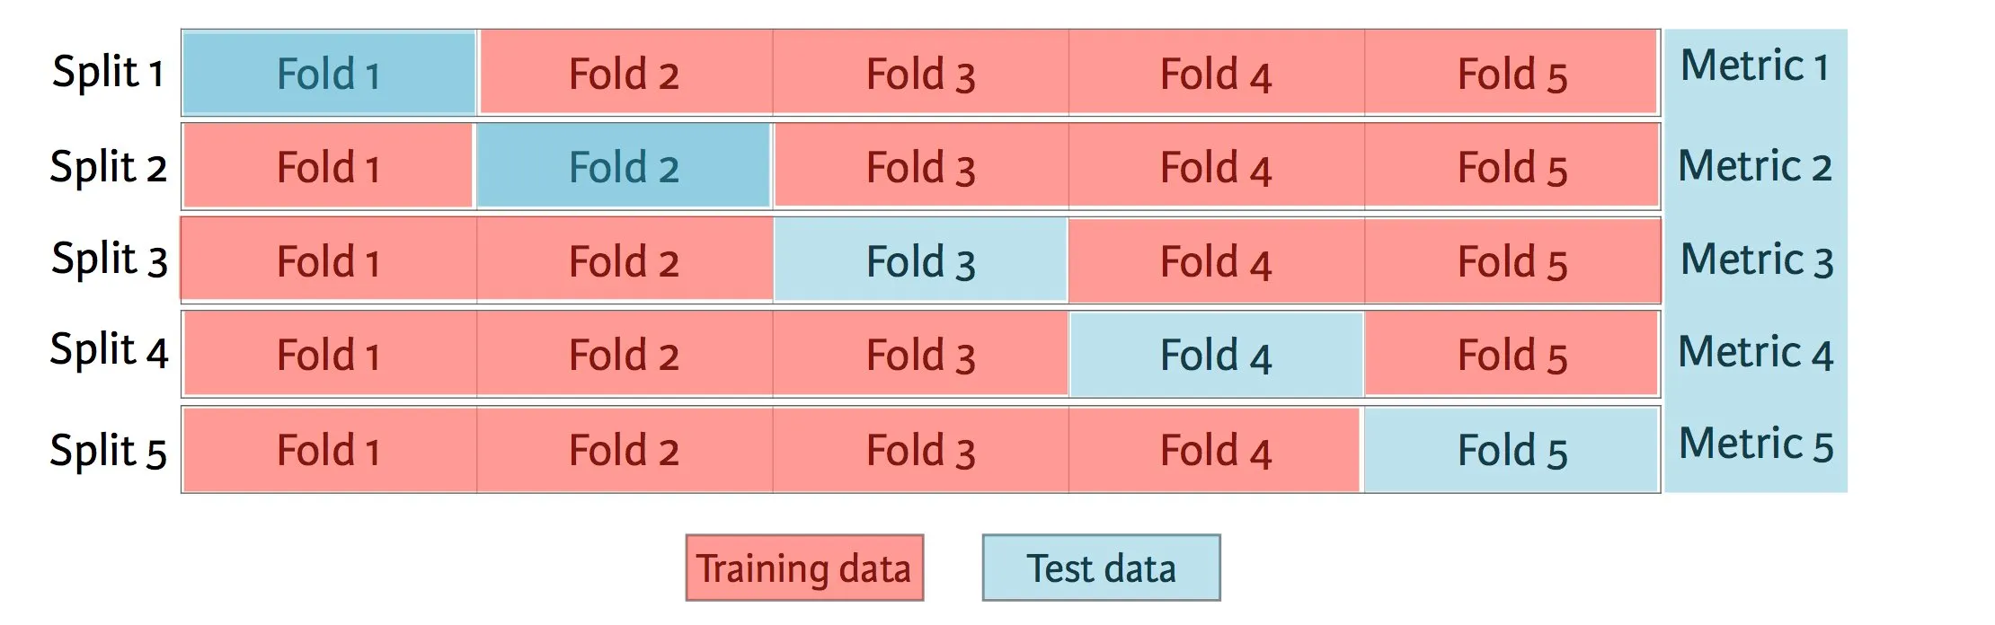
Cross-validation Example
5-fold cross-validation
The overall test error rate is obtained by summing up the number of errors committed in each test subset across all runs and dividing it by the total number of instances.

Slide 98
Cross-validation Example
The k-fold cross-validation method generalizes this approach by segmenting the labeled data D (of size N) into k equal-sized partitions (or folds).
During the ith run, one of the partitions of D is chosen as D.test(i) for testing, while the rest of the partitions are used as D.train(i) for training.
A model m(i) is learned using D.train(i) and applied on D.test(i) to obtain the sum of test errors, errsum(i).
This procedure is repeated k times. The total test error rate, errtest, is then computed as

Slide 99
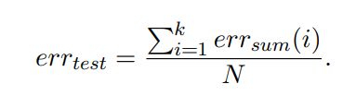
Cross-validation Example
Every instance in the data is thus used for testing exactly once and for training exactly (k − 1) times.
Also, every run uses (k − 1)/k fraction of the data for training and 1/k fraction for testing.
The right choice of k in k-fold cross-validation depends on a number of characteristics of the problem.

Slide 100
Cross-validation Example
A small value of k will result in a smaller training set at every run, which will result in a larger estimate of generalization error rate than what is expected of a model trained over the entire labeled set.
On the other hand, a high value of k results in a larger training set at every run, which reduces the bias in the estimate of generalization error rate
leave-one-out approach
when k = N, every run uses exactly one data instance for testing and the remainder of the data for testing

Slide 101
Cross-validation Example
Smaller values of K means that the dataset is split into fewer parts, but each part
contains a larger percentage of the dataset.
Taking a dataset with 100 rows.
2 fold cross validation - Each fold will contain 50 rows.
10 fold cross validation - Each fold will contain 10 rows.
This way, when training, the 10 fold cross validation will have a 90-10 train-test split, where as the 2 fold cross validation will have a 50-50 train test split.
Making use of more folds, will present the model with more data to train on, but will required way more time as it has to train and validate K separate times.

Slide 102
Variations on Cross-validation
Repeated cross-validation
Perform cross-validation a number of times
Gives an estimate of the variance of the generalization error
Stratified cross-validation
Guarantee the same percentage of class labels in training and test
Important when classes are imbalanced and the sample is small
Use nested cross-validation approach for model selection and evaluation

Slide 103
Variations on Cross-validation
Stratified cross-validation

Slide 104
THANK YOU

Slide 105
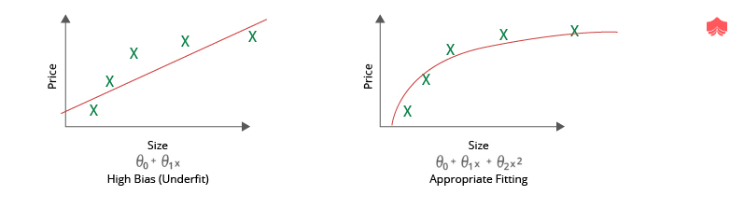
Out of the box discussion – may be useful (Bias)
Bias is difference between the model predicted value and actual value.
Bias is one type of error which occurs due to wrong assumptions about data such as assuming data is linear when in reality, data follows a complex function.
Occurs when model pays little attention to the underlying data. Even if we provide more training samples a low bias model does not change.
It is basically underfitting of data.
Linear regression, logistic regression etc suffer from low bias

Slide 106
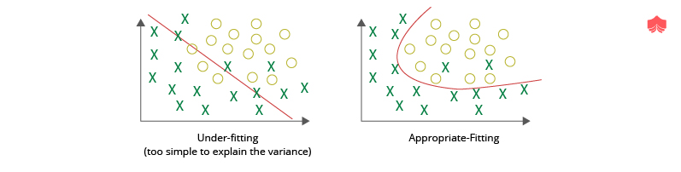
Out of the box discussion – may be useful (Bias)

Slide 107
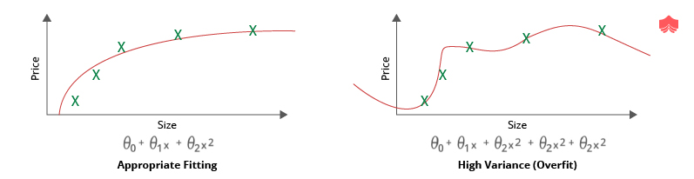
Out of the box discussion – may be useful (Variance)
Variance is the difference in the model prediction on the train and test data.
It is the difference between many model's predictions(fluctuating)
If the model performs well on the training data (low training error) but fails to generalize well to the test data (high test dataset error), it is said to have a high variance.
This essentially means that your model is overfitting the training data.
It can be because the model captures random noise in the data or it has not seen enough data in the training to generalize well to the unseen examples.

Slide 108
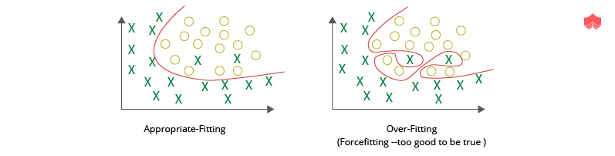
Out of the box discussion – may be useful (Variance)

Slide 109
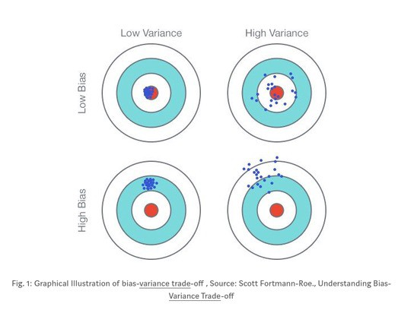
Out of the box discussion – may be useful Bias – Variance Dilemma
To decrease the bias, we need to increase the model complexity, which means the variance increases.
To lower the variance means the model may not fit the data well and hence the bias increases.
An optimal model is one that make good trade-off between two.

Slide 110
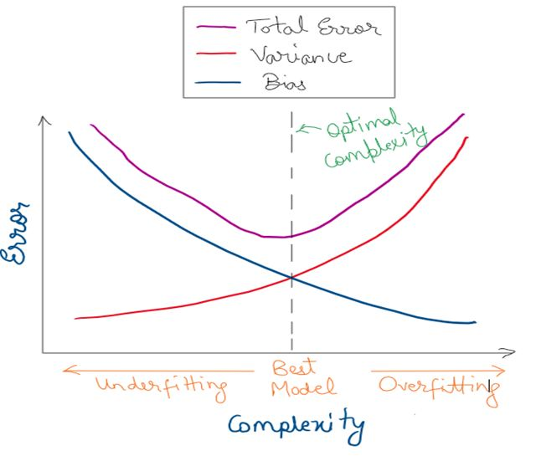
Out of the box discussion – may be useful

Slide 111
Out of the box discussion – may be useful
To avoid underfitting (high bias)
Try to increase complexity of model
Train for longer time
Try to increase the number of features by finding new features or making new features from the existing ones.
Decrease regularization
Use different model
To avoid overfitting (high variance), try the following –
Increase the training data (collecting more data/augment the training dataset)
Less complex model
Early stop(reduce epocs)
Remove features (not recommended )
Ensembling
L1/L2 regularization to simplify your model.

Slide 112
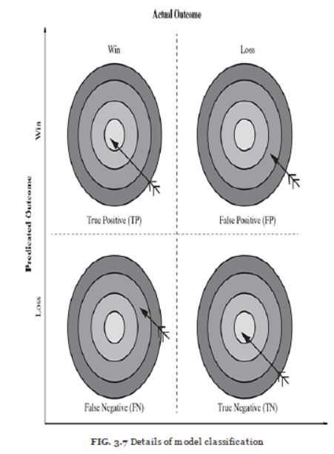
EVALUATING PERFORMANCE OF A MODEL- Supervised learning - classification
A true positive is an outcome where the model correctly predicts the positive class. Similarly,
a true negative is an outcome where the model correctly predicts the negative class.
A false positive is an outcome where the model incorrectly predicts the positive class.
And a false negative is an outcome where the model incorrectly predicts the negative class.
1 . the model predicted win and the team won
2 . the model predicted win and the team lost
3 . the model predicted loss and the team won
4 . the model predicted loss and the team lost

Slide 113
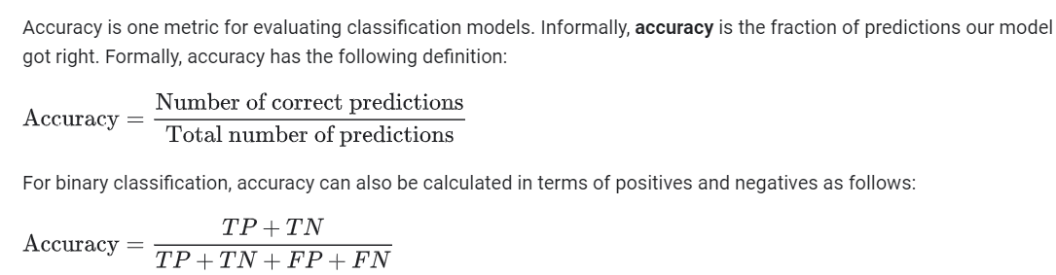
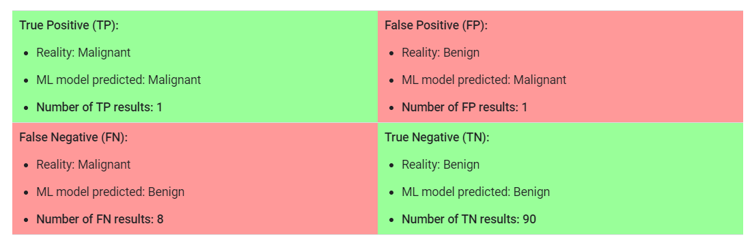

Slide 114
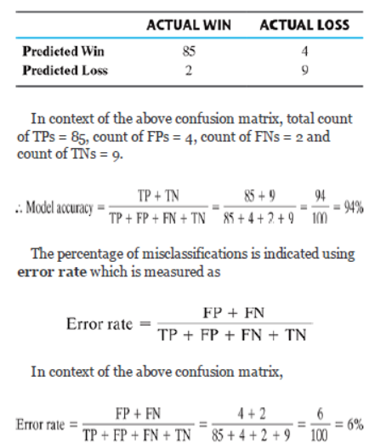
confusion matrix
A matrix containing correct and incorrect predictions in the form of TPs, FPs, FNs and TNs is known as confusion matrix.

Slide 115
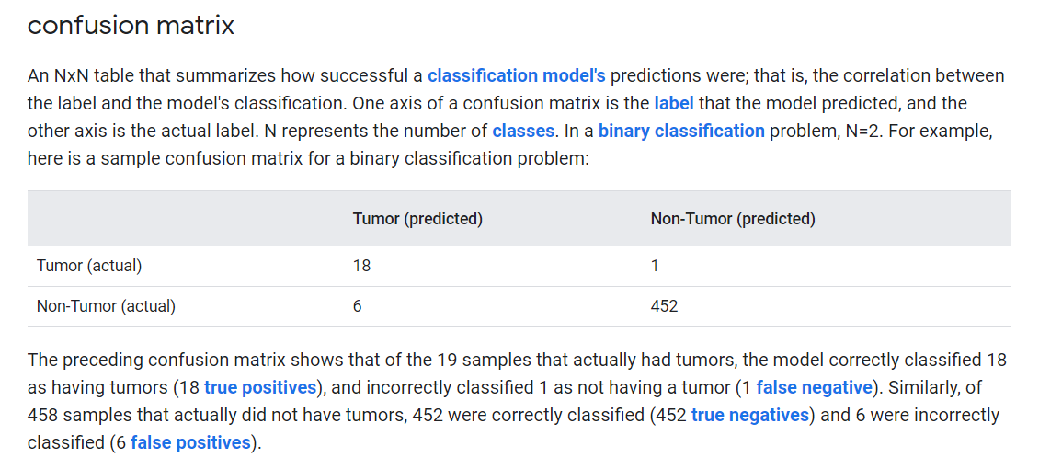

Slide 116

Sensitivity and specificity
The sensitivity of a model measures the proportion of TP examples or positive cases which were correctly classified.
Specificity of a model measures the proportion of negative examples which have been correctly classified.

Slide 117


Slide 118


Slide 119

F-measure is another measure of model performance which combines the precision and recall. It takes the harmonic mean of precision and recall as calculated as

Slide 120



Numerical Problem

Slide 121


Kappa value of a model indicates the adjusted the model accuracy. It is calculated using the formula below

Slide 122


